Slide 1
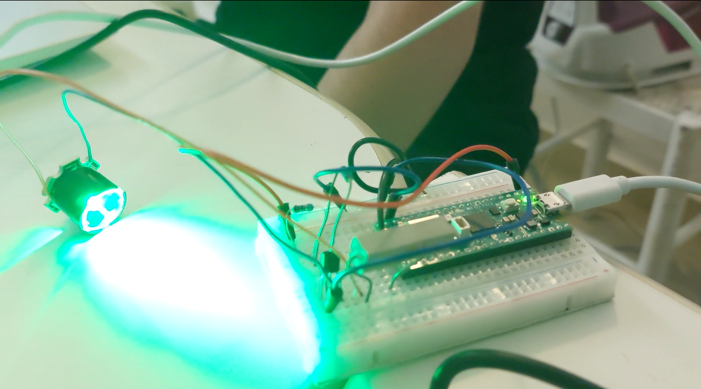



Underwater Optical Wireless Communications
Ricardo Rodrigues
Mauro Cordeiro
Afonso Frazão
Rodrigo Quina
André Salvaterra

Slide 2

Introduction
Have you ever thought why most divers still use hand signals ?
2

Slide 3

Problem definition
Underwater communications practices haven’t evolved in over 50 years. Most divers use hand signals to transmit messages to each other, which requires both parties to be in each others line of sight.
The current usual methods are either hard-wired communications or wireless communications to communicate between divers or communications between boat and diver.

Slide 4
Technological solution – Overview
We will be implementing an Underwater Optical Wireless Communications (UOWC) system using:
Microcontrolelr for signal processing.
On-Off Keying as the modulation scheme.
LED tuned to Blue/Green (≈525nm) light spectrum .
Hamming(7,4) as the Error Correction Code algorithm.

Slide 5
Technological solution – UOWC
The usual methods of wireless communication in an underwater environment are radio frequency (RF), sound (Acoustic) or hybrid (RF and Acoustic). A (comparatively) newer alternative currently being explored is optical communications.
UOWC has the advantage of using simpler modulation schemes, needing lower power, and having higher data rates at short ranges.

Slide 6
Technological solution – Optical Wavelength
Conceptual role
Reason for choosing
The used wavelength is constrained by the medium (underwater). In our case, we are using visible light (380 - 750).
Some wavelengths will be better suited for specific water conditions than others.
We picked the ≈500nm range (closer to green than blue) due to the available components for our use, and due to its lower attenuation on ocean water.

Slide 7
Technological solution – Signal Processing
Conceptual role
Reason for Choosing
We will be using an MCU to process audio signals in real time and modulate and de-modulate the outgoing and incoming signals.
We picked the Raspberry PI Pico (For now) due to its sufficient computational power at low price.

Slide 8
Technological solution – ECC Algorithm
Conceptual Role
Reason for choosing
Because we have no practical way of confirming the uncorrupted arrival of data to the intended receiver an ECC is a good way to be able to circumvent possible errors that could happen during the transmission.
We are going to use the hamming (7,4) algorithm, because it is simple, low cost, and effective.
We will also (possibly) be using interleaving to circumvent burst errors.

Slide 9
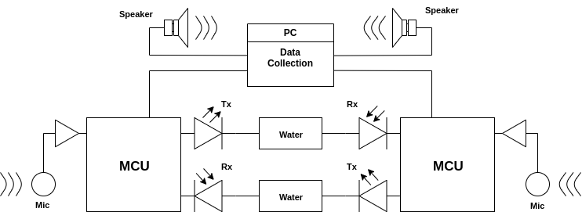
Technological solution (Block Diagram)
Block Diagram of the prototype

Slide 10
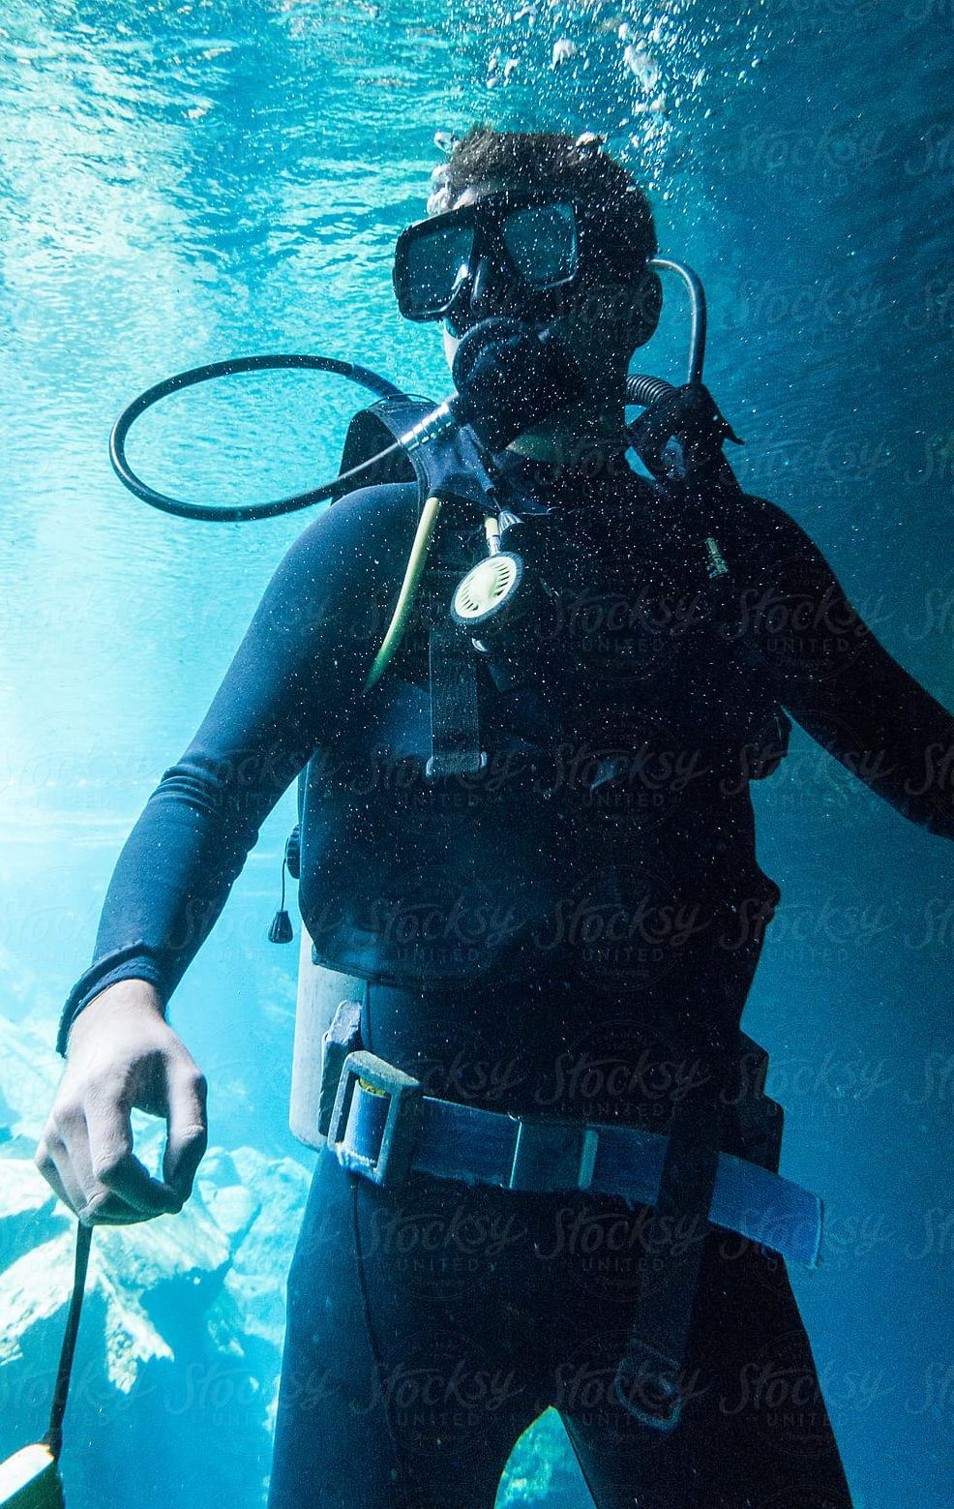
Solution beneficiaries
The intended target audience are scuba divers that don't use any kind of underwater communication (besides the traditional methods) and scuba divers who are looking for an alternative to wire and wireless communications.
This solution could possibly be used by diving schools when teaching courses (ranging from a variety of difficulty) and in recreational buddy diving, replacing hand signals as a more sophisticated way of communicating.
Font: Image Bank

Slide 11
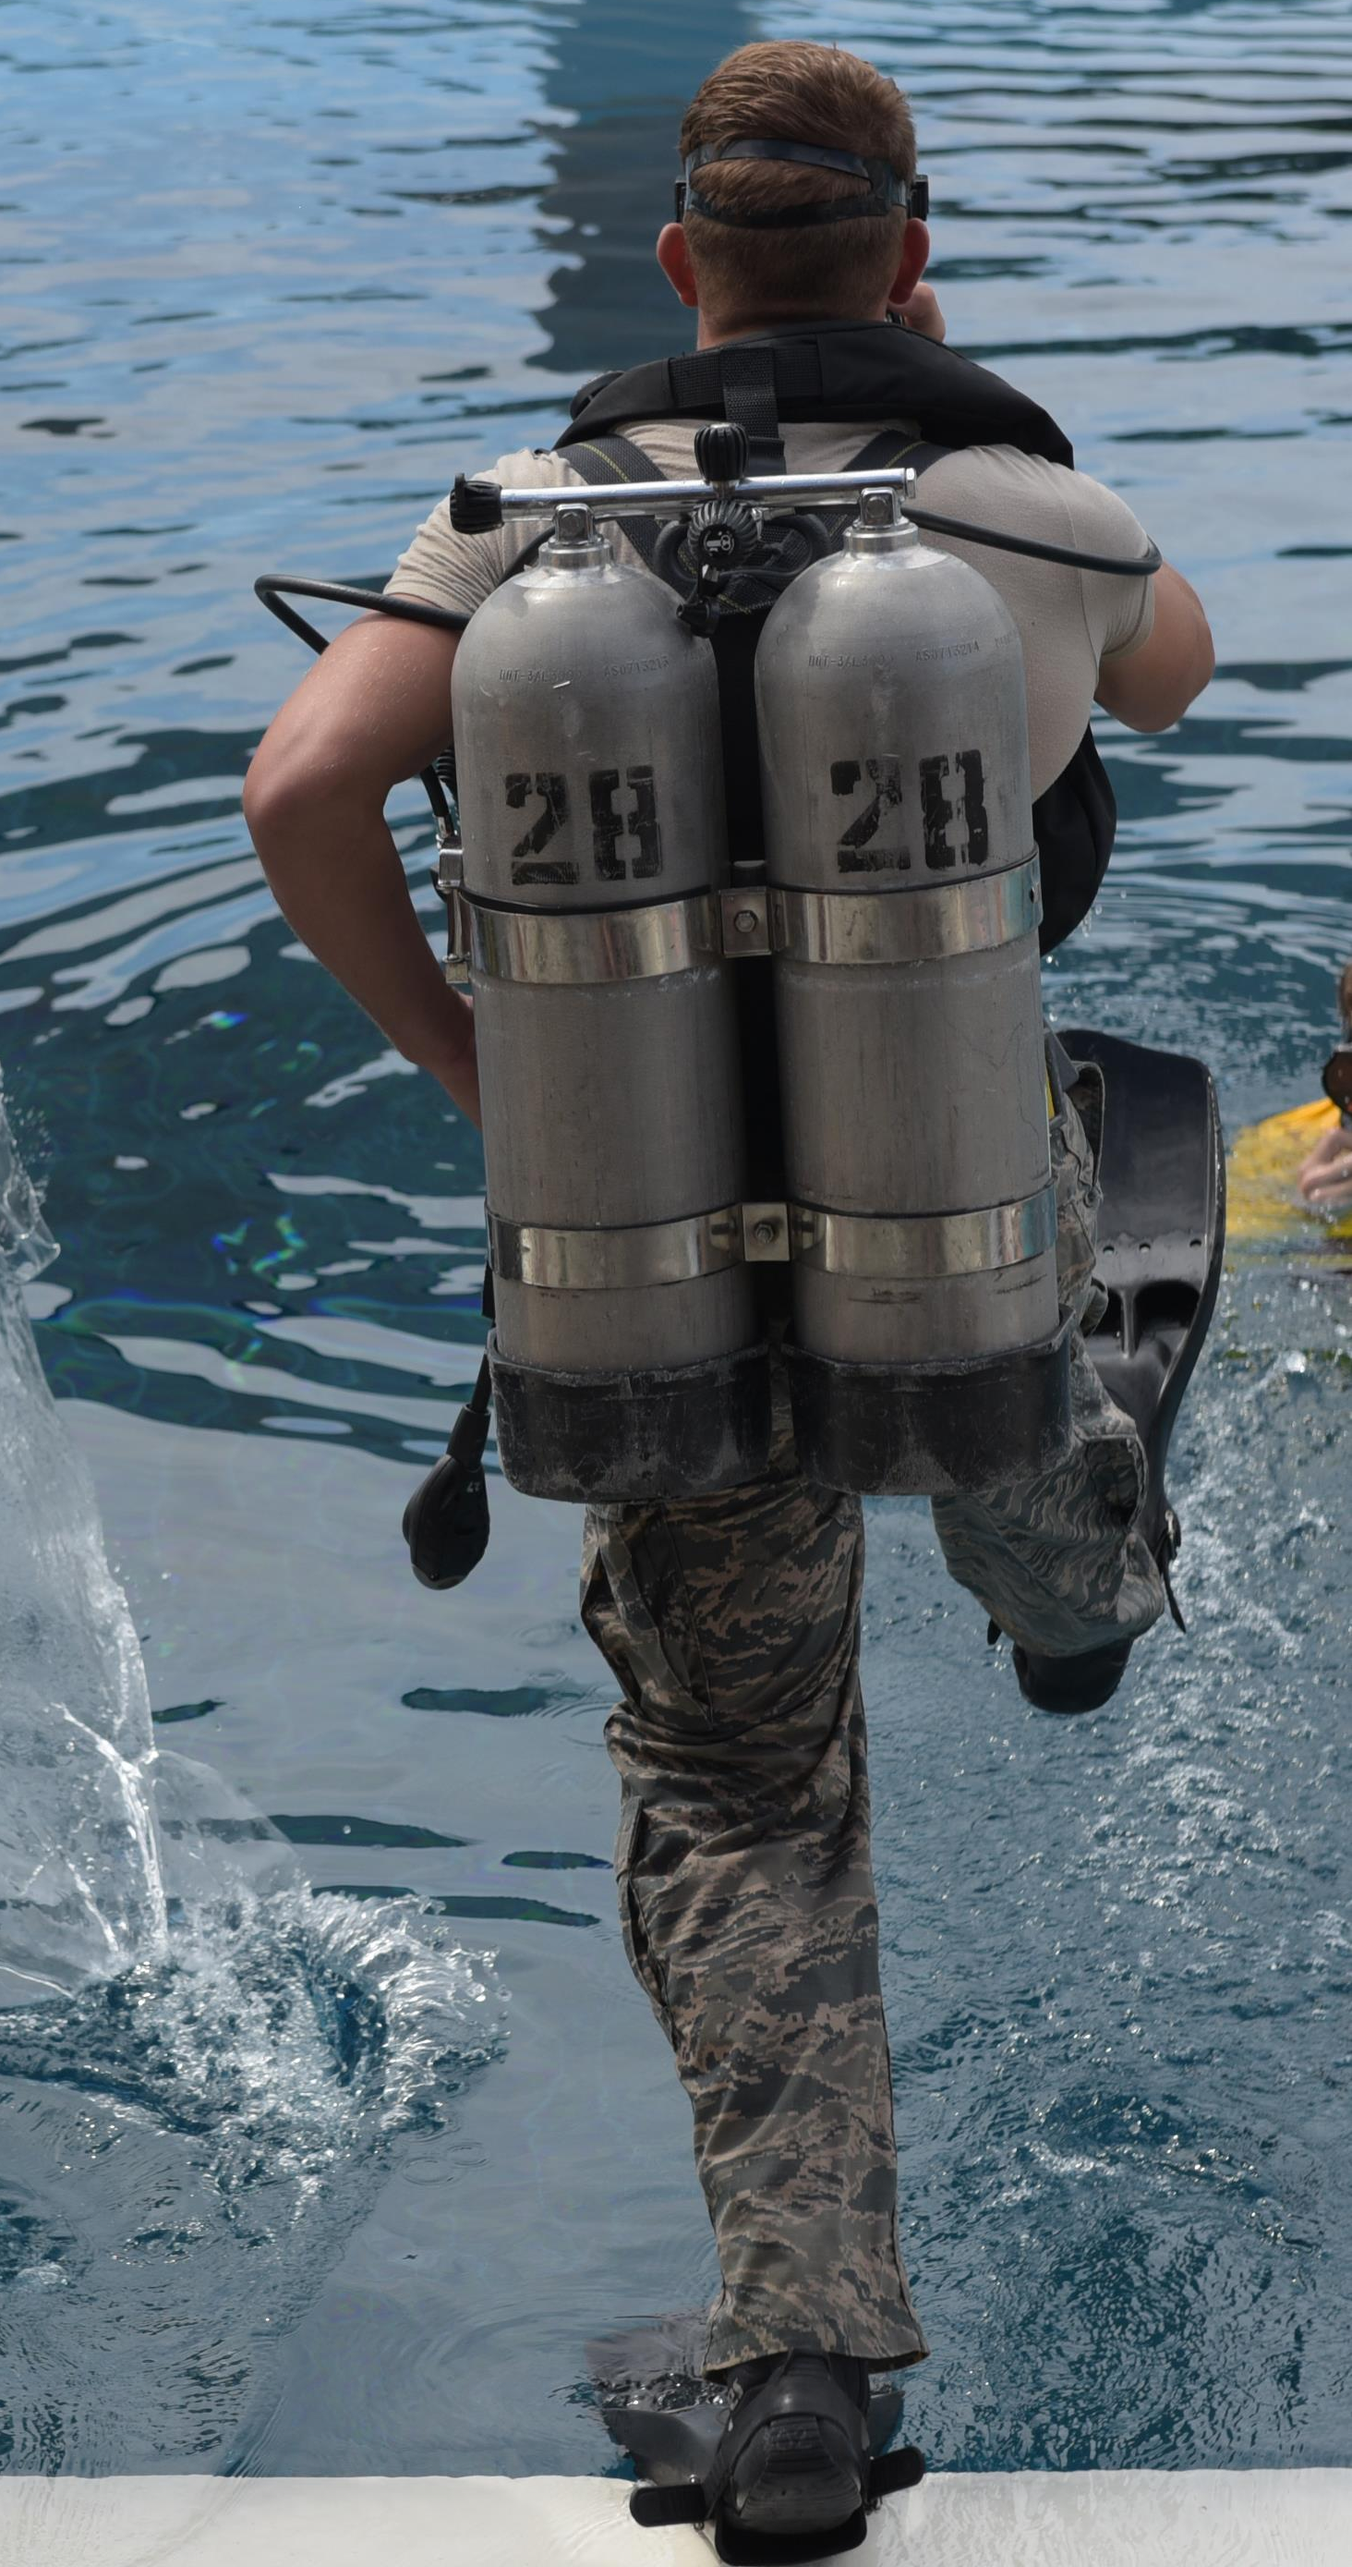
Solution beneficiaries
In a larger scale, there is ground for the utilization of this solution in emergency and rescue operations, as well in search and recovery missions and in underwater construction and maintenance, just to name a few applications. We predict that in these scenarios there'll possibly be a transmitter giving instructions to a receiver who is eventually doing the necessary work.
Font: Air Combat Command
₆

Slide 12
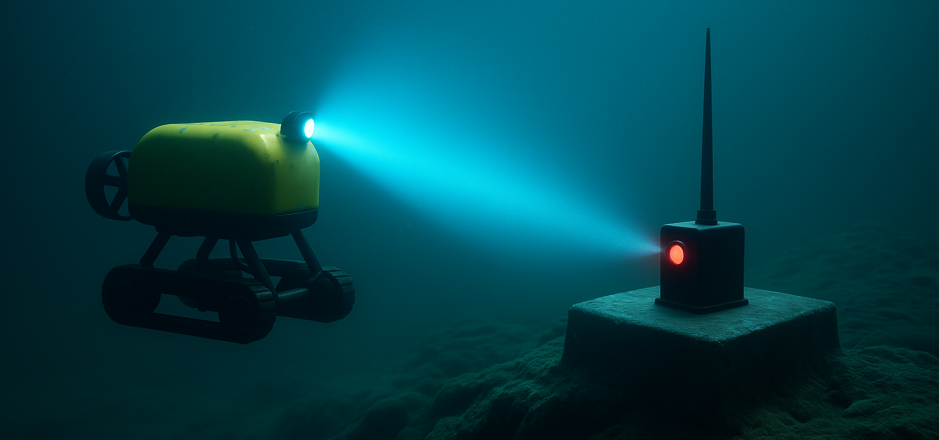
Solution beneficiaries
It was also discussed with the DSOR group the possibility of using this technology when transmitting data between an autonomous underwater vehicle and its bay.
Font: AI Generated

Slide 13
Competitors and previous work
Hard-wired communications: clear and steady communication without interference caused by water.
Acoustic waves: very long range in deep waters, but low bandwidth, high latency, and high sensitivity to the environment.
EM waves (in RF): quick data acquisition and transmission over short distances in clear waters. However, they are very easily attenuated.
Hybrid systems.
Use of 5G technologies and IoUT.
LiFi.

Slide 14
Competitors and previous work
Both Hard-Wired and Wireless:
https://oceantechnologysystems.com/
https://diving.oceanreefgroup.com/underwater-communication/
Our main source of information:
https://pmc.ncbi.nlm.nih.gov/articles/PMC7219055/pdf/sensors-20-02261.pdf

Slide 15
Competitors and previous work
Hard-wired communications consists of a helmet with a wire that transmits audio signals to the surface, ensuring clear and steady communication with the people on the boat, without interference caused by the water.
A way of wireless communication is the use of acoustic waves. Divers use transducers to send and receive signals, allowing bidirectional communication. It is characterized by a very long range (several kms) in deep waters, but has low bandwidth, high latency, and is very sensitive to ambient noise, external interference and Doppler spreading.

Slide 16
Competitors and previous work
Another type of technology is the use of EM waves in radio frequency, which is capable of quick data acquisition and transmission over short distances in clear waters. However, it falls behind due to the waves being very easily attenuated.
UWOC serves as a balance between acoustic and RF communication, allowing for quick data transmission over medium distances, with low latency. Its main disadvantages are its issued regarding absorption and its sensitivity to different types of noise, such as quantum, background, optical excess and photo-detector black current noise.

Slide 17
Competitors and previous work
Lastly, it has also come up another approach to Underwater Wireless Communication, which is the use of hybrid systems, such as a mix between the acoustic and optical approaches, combining speed with long distances.
There is also ongoing research about the use of 5G technologies in underwater communication, as well as the prospect of integrating the Internet of Underwater Things (IoUT) in underwater communication networks.

Slide 18

Competitors and previous work
LiFi is a fast, efficient and low-latency way of transmitting audio wirelessly via LASER light.
The transmitter circuit consists of a microphone to detect the messaged followed up by an amplifier. The amplified signal is then sent to the receiver through a laser diode.
The receiver end has a light-based sensor to detect the signal, which is followed by another amplifier that emits the sent and then subsequently received audio message.
Its disadvantages are its limited range, light obstruction and Line-Of-Sight requirement.
Li
Fi

Slide 19





Team
Ricardo Rodrigues
Rodrigo Quina
Mauro Cordeiro
André Salvaterra
Afonso Frazão

Slide 20



Partners
DSOR (Dynamical Systems and Ocean Robotics) from ISR;
CPAS (Centro Português de Atividades Subaquáticas).

Slide 21
Testing
Testing:
Test modulation of a sample signal with the microcontroller software.
Test receiving and demodulation of sample signals with the microcontroller software.
Test prototype with error detection/correction
Test limitations
After we get a working prototype outside of water, start testing underwater with the water-proof equipment ready.
Repeat the outside of water testing but underwater.

Slide 22
Achieved Results –Prototype
Our current prototype (Not based on optical communications), with NRZ-OOK and no ECC:
Transmition Rate – 10 KHz
5cm – 0 bit error rate
7.5cm - 0.241 bit error rate

Slide 23
Contribution of each team-member
Tarefas | Ricardo | Mauro | Afonso | André | Rodrigo
Website development | X |  | x
Pre prototype hardware development |  | X | X
Pre prototype software development |  | X | X | X
Literature search and reading | X | X | X | X | X
Presentation Elaboration | X | X | x | x | x
Finding partners | X |  | X |  | X
Interviewing | X |  | X | X | X
Blog writing |  |  |  |  | X
X – Big Contribution x – Smaller Contribution

Slide 24
Contribution of each team-member
Tarefas | Ricardo | Mauro | Afonso | André | Rodrigo
Website development | X |  | x
Pre prototype hardware development |  | X | X
Pre prototype software development |  | X | X | X
Literature search and reading | X | X | X | X | X
Presentation Elaboration | X | X | x | x | x
Finding partners | X |  | X |  | X
Interviewing | X |  | X | X | X
Blog writing |  |  |  |  | X
X – Big Contribution x – Smaller Contribution

Slide 25
Costs and benefits
The most expensive would be the photodiode receptor, that can vary between 10€ - 50€. After that all the other components are relatevely cheap.
This means that our solution can be affordable for divers, avoiding our competitors more expensive solutions.

Slide 26
Useful Links
Landing Page – http://uowc.duckdns.org/#home
Blog - http://uowc.duckdns.org/#blog-posts
Link to useful files (Video) - http://uowc.duckdns.org/html/files-page.html
Our Website - http://uowc.duckdns.org

